Slide 1
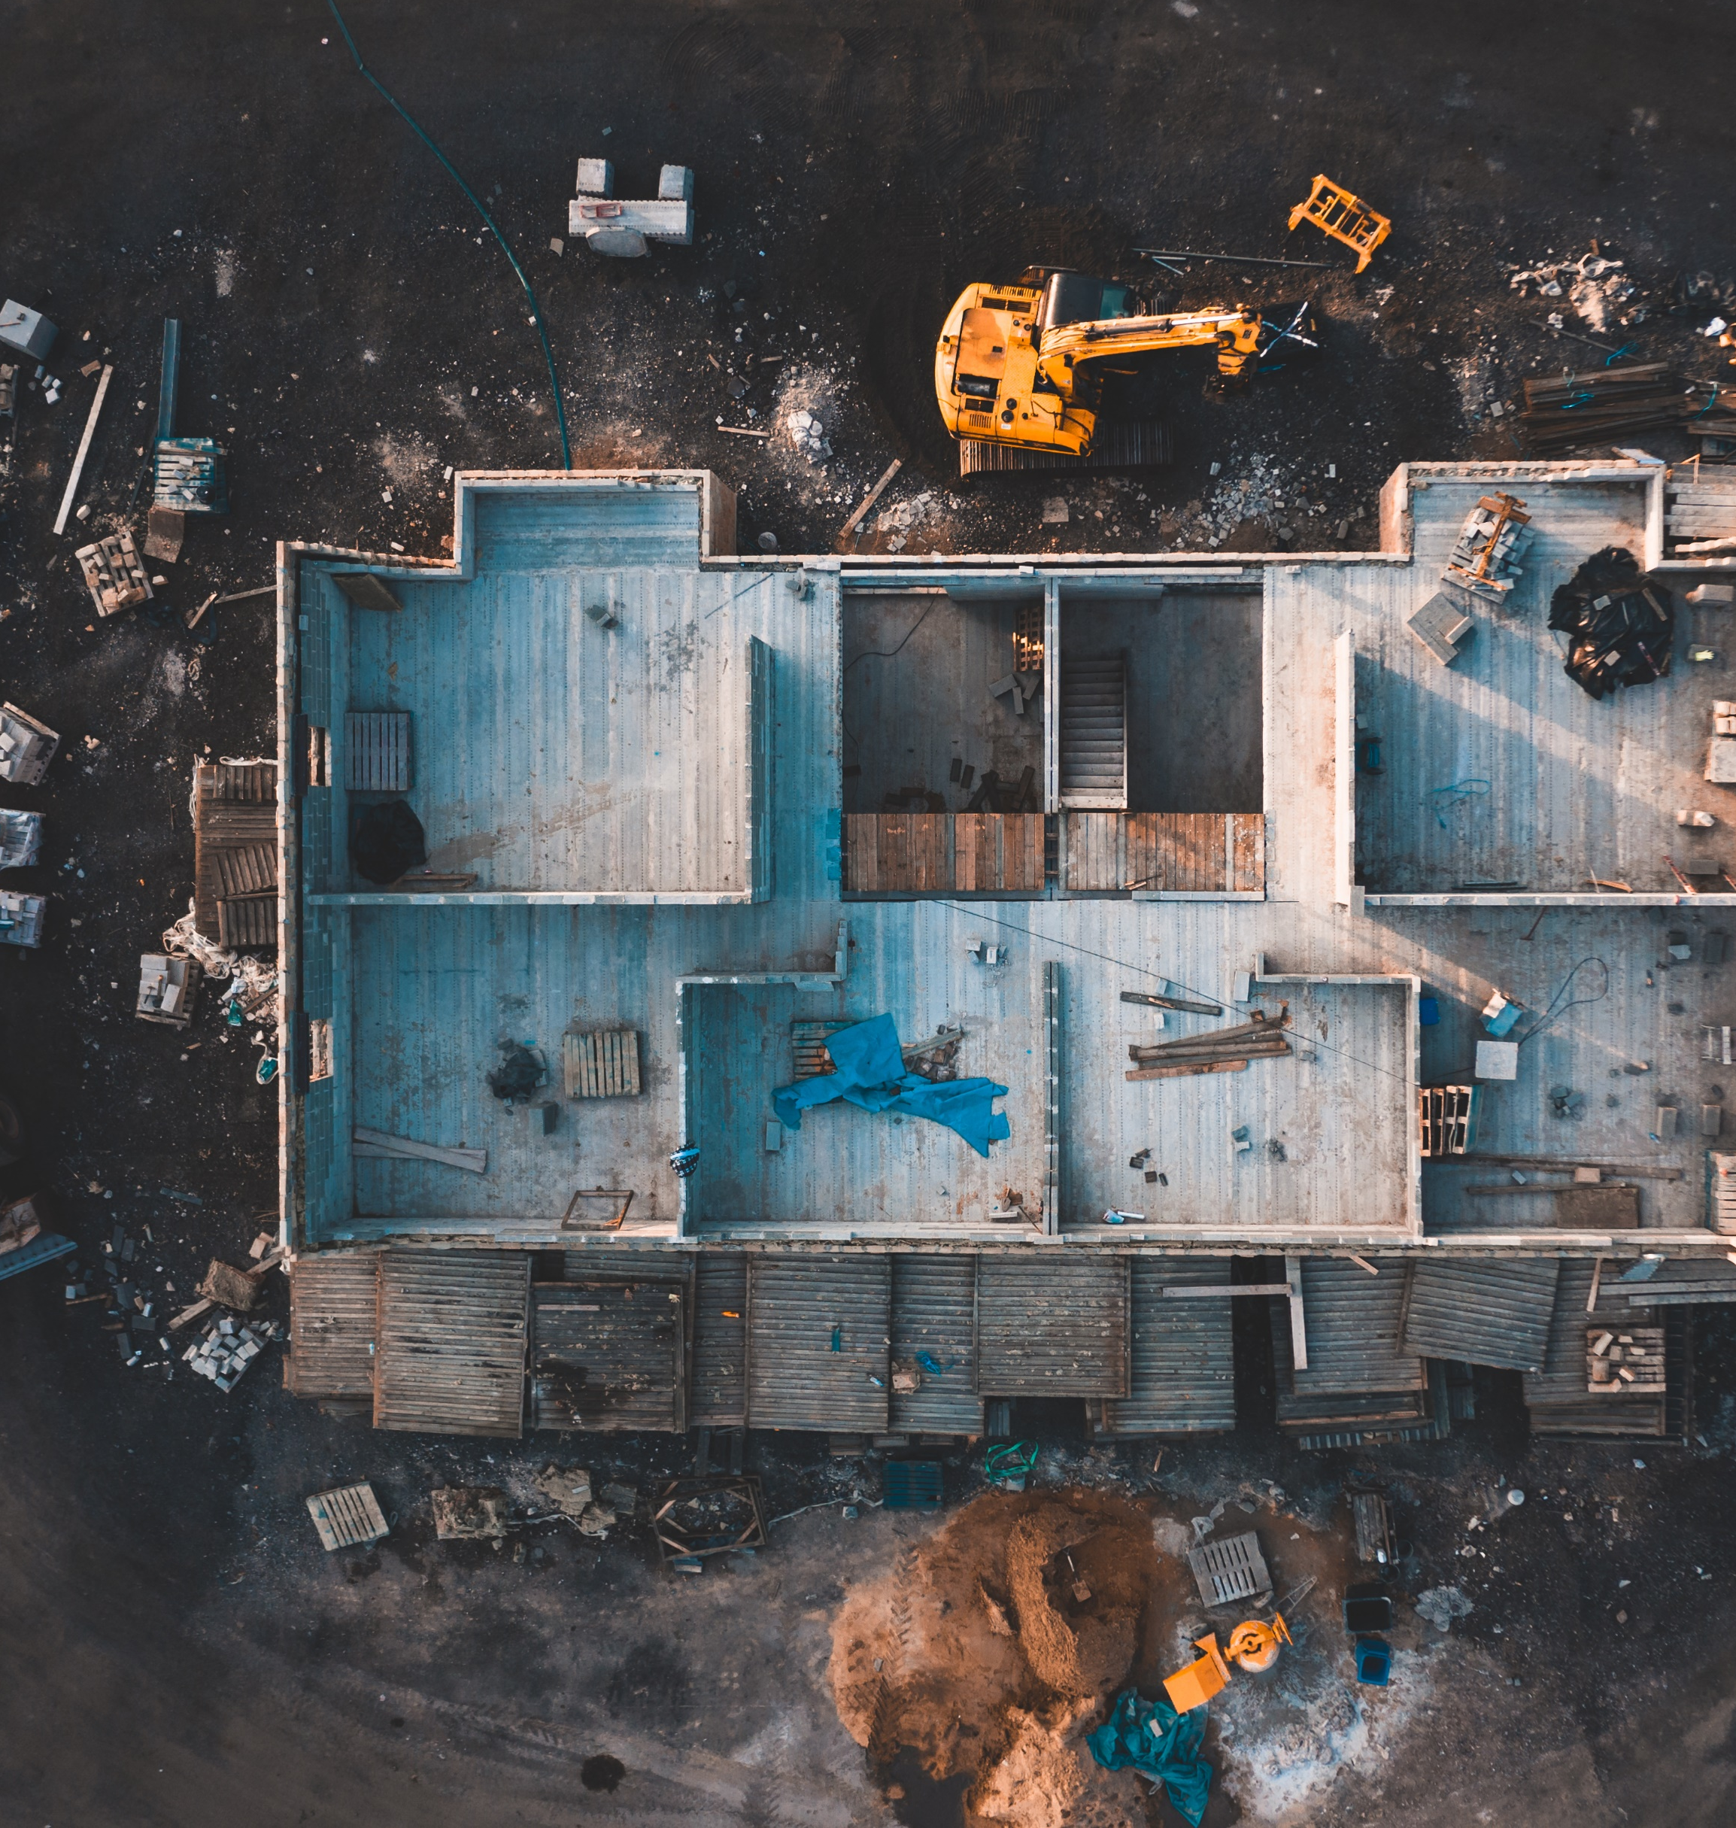
Optimization of Waste Clean-Up After Large Scale Disasters
Project Progress Presentation

Slide 2
GTU COMPUTER ENGINEERING CSE 495 / 496 PRESENTATION
Çağrı Yıldız – Furkan Taşkın
Project Advisor: Prof. Dr. Didem Gözüpek Kocaman
Article: C. Cheng, R. Zhu, A. M. Costa, and R. G. Thompson, “Optimisation of waste clean-up after large-scale disasters,” Waste Management, vol. 119, pp. 1–10, 2021. https://doi.org/10.1016/j.wasman.2020.09.023
December 2024

Slide 3
Content
Timeline
Model Implementation Progress
Parameters & Variables
Constraints & Mathematical Model
Progress Since First Meeting
Current Progress
References
Success Criteria
Next Steps

Slide 4
Project Overview and Objectives
Develop optimization model for post-disaster waste management
Focus on minimizing total clean-up cost and time
Consider building demolition scheduling and waste collection routing
Optimize temporary waste management site locations
Create implementable solutions for real-world scenarios

Slide 5
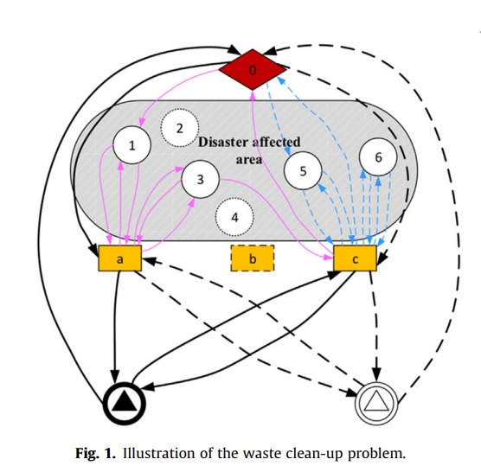
SCHEMA OF THE PROJECT
The diagram illustrates key steps:
1. Depot: Starting and return point for all vehicles each day.
2. Customer Nodes: Points where waste is collected.
3. Temporary Waste Management Sites (TDWMS): Short-term storage locations.
4. Landfill: Final disposal area for collected waste

Slide 6
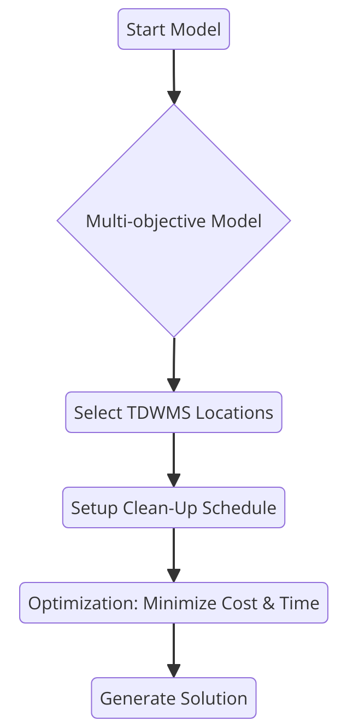
Project Design Plan
Start Model: Collect data and set limits for waste clean-up.
Multi-Objective Model: Focus on minimizing cost and time for clean-up.
Choose TDWMS Locations: Select optimal sites for waste storage to save time and costs.
Set Up Schedule: Plan when and where to collect waste.
Optimize: Use the model to reduce costs and time efficiently.
Create Solution: Develop the best plan for fast, cost-effective clean-up.
GTU – COMPUTER ENGINEERING DEPARTMENT CSE 495/496 1

Slide 7
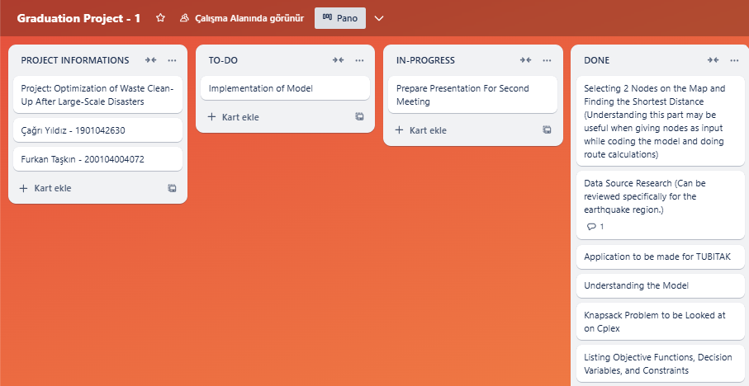
Timeline
GTU – COMPUTER ENGINEERING DEPARTMENT CSE 495/496 2

Slide 8
Model Implementation Progress
• Understanding model components and constraints
• Analyzing objective functions and decision variables
• Review of reference materials and documentation
GTU – COMPUTER ENGINEERING DEPARTMENT CSE 495/496 3

Slide 9
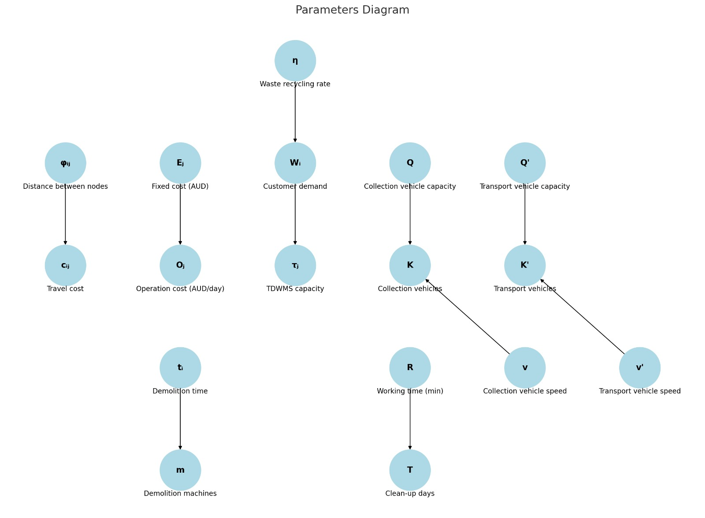
Parameters
GTU – COMPUTER ENGINEERING DEPARTMENT CSE 495/496 4

Slide 10
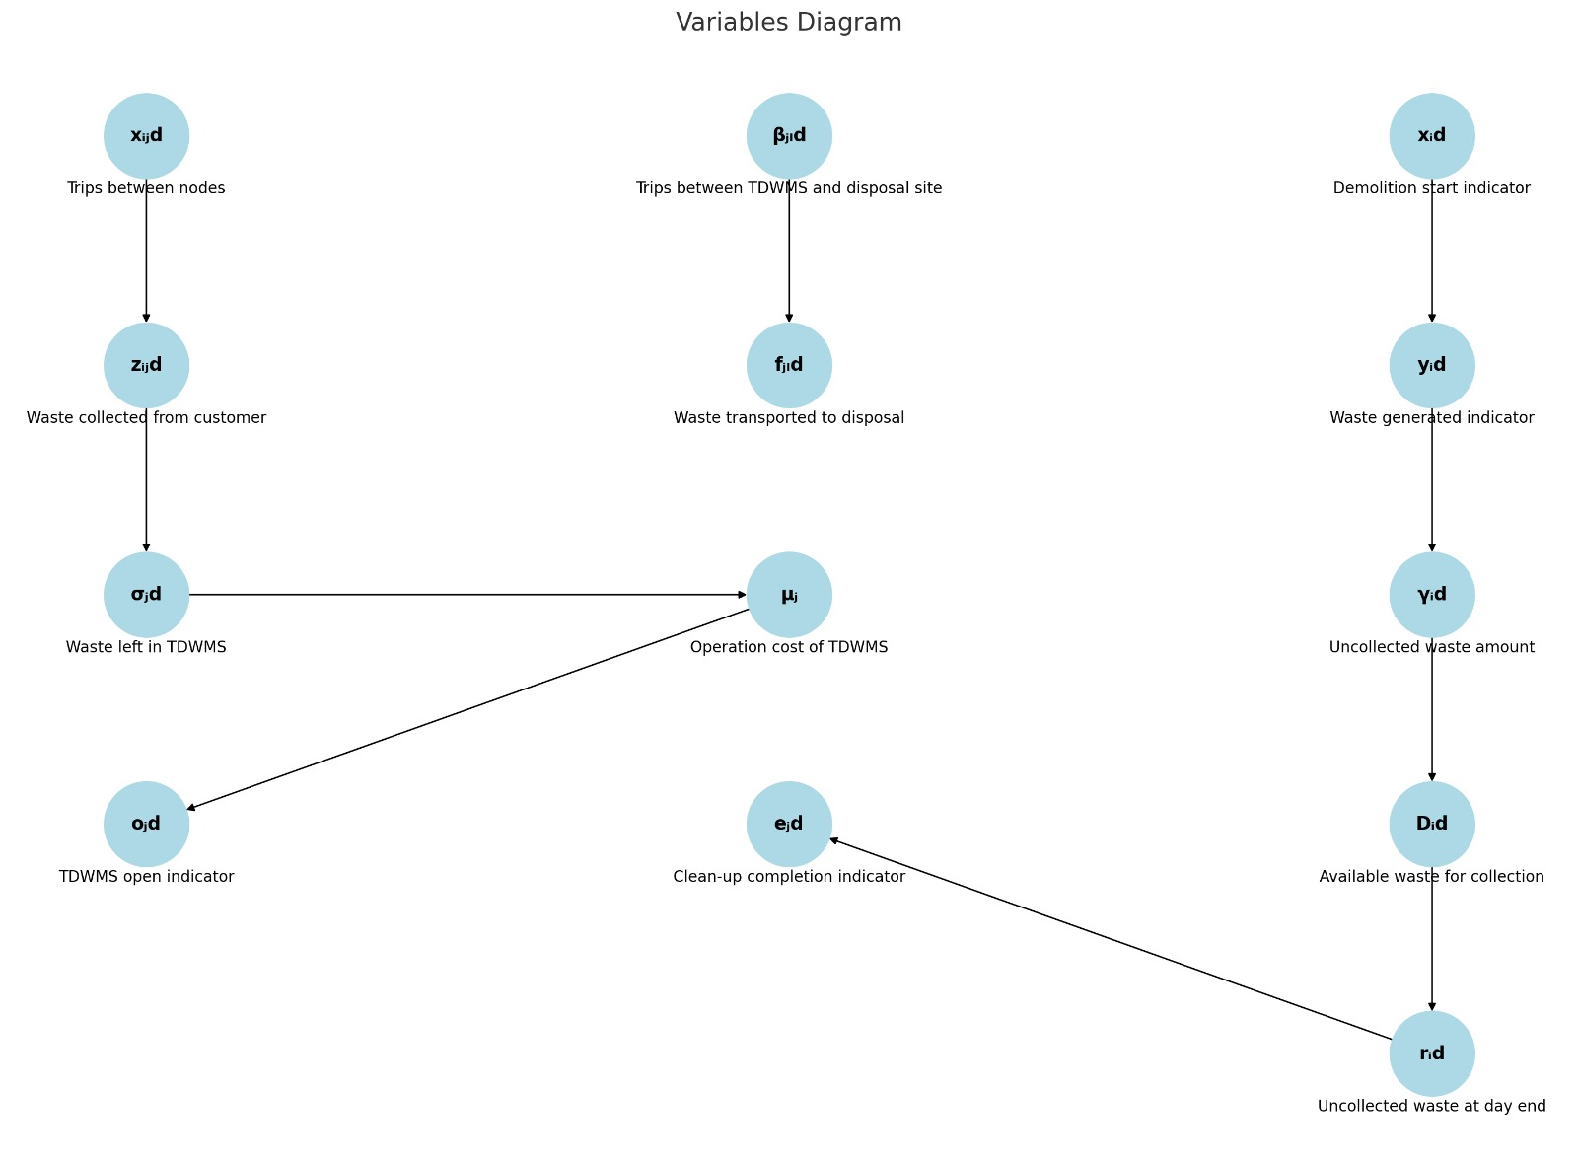
Variables
GTU – COMPUTER ENGINEERING DEPARTMENT CSE 495/496 5

Slide 11
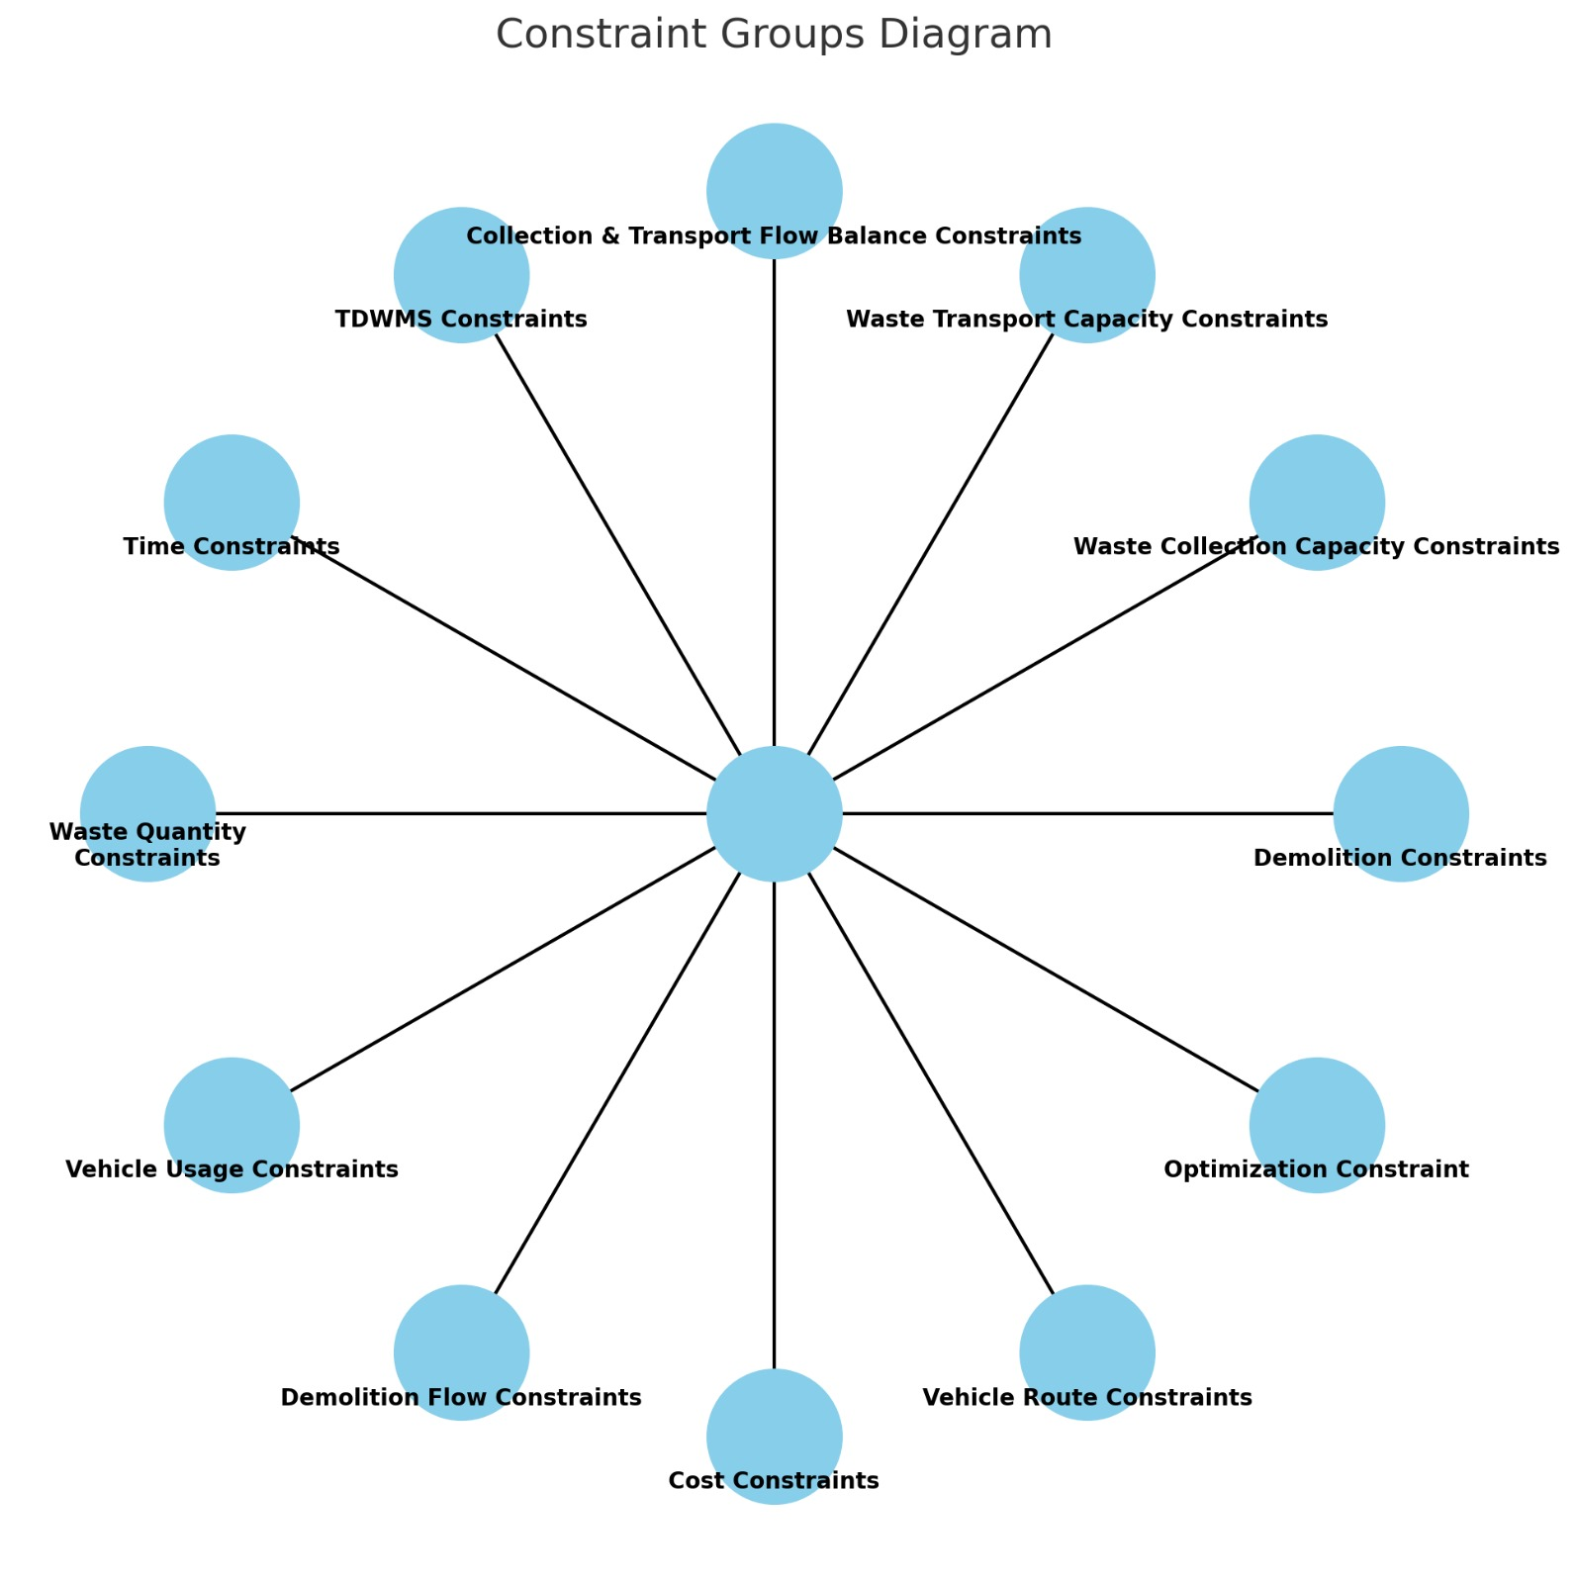
Constraints
GTU – COMPUTER ENGINEERING DEPARTMENT CSE 495/496 6

Slide 12
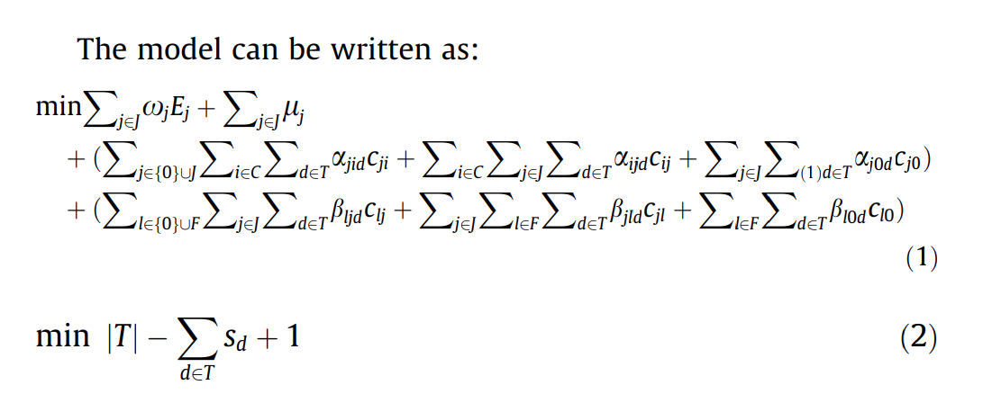
The Mathematicial Model

Slide 13
Progress Since First Meeting
• Analyzing research paper results section
• Working on TUBITAK application
• Researching Data from Earthquake Zone
• Implementing shortest path algorithm between nodes
GTU – COMPUTER ENGINEERING DEPARTMENT CSE 495/496 7

Slide 14
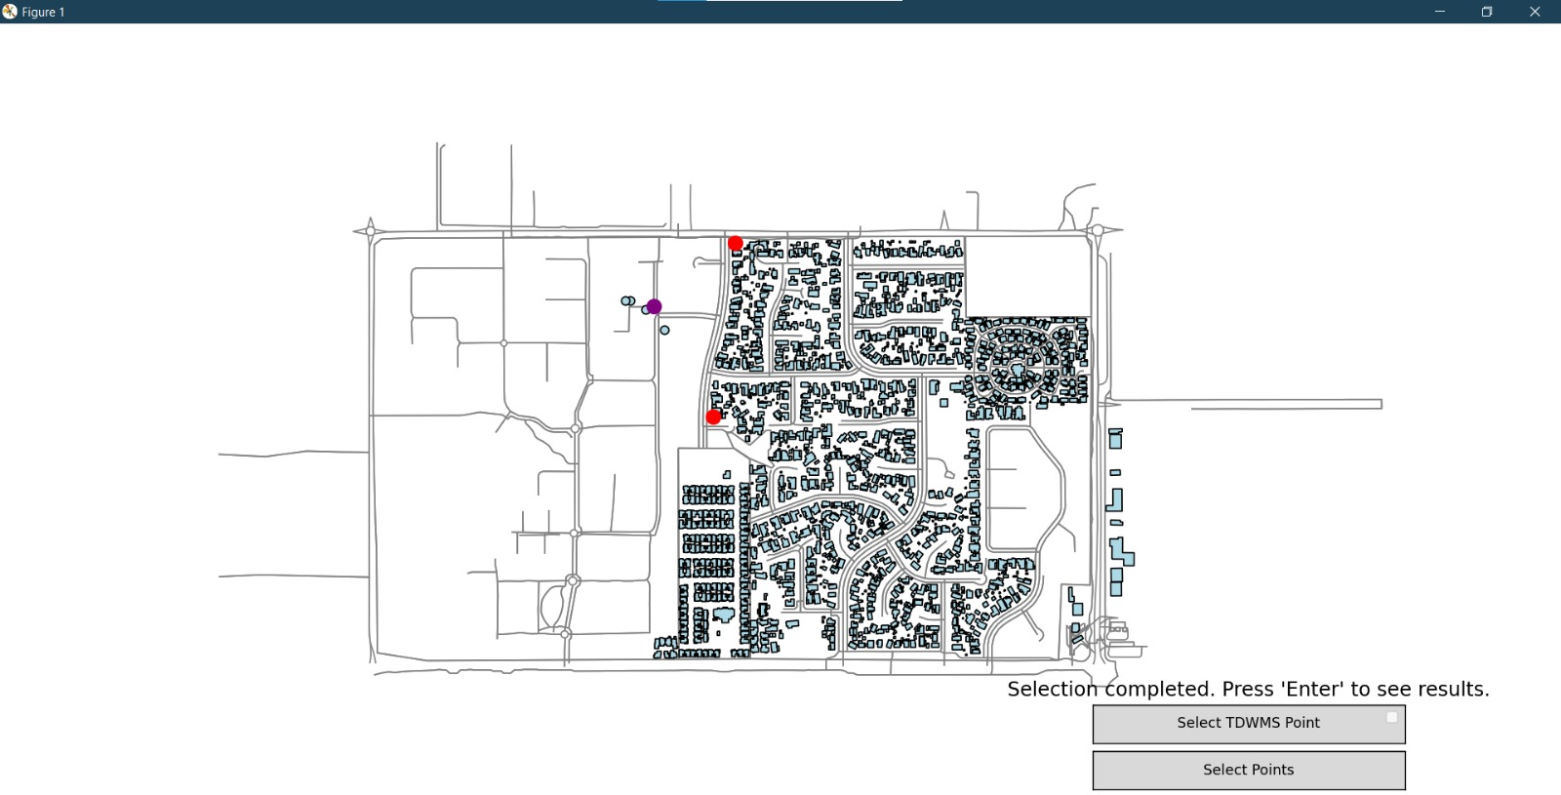
Current Progress-1
GTU – COMPUTER ENGINEERING DEPARTMENT CSE 495/496 8

Slide 15
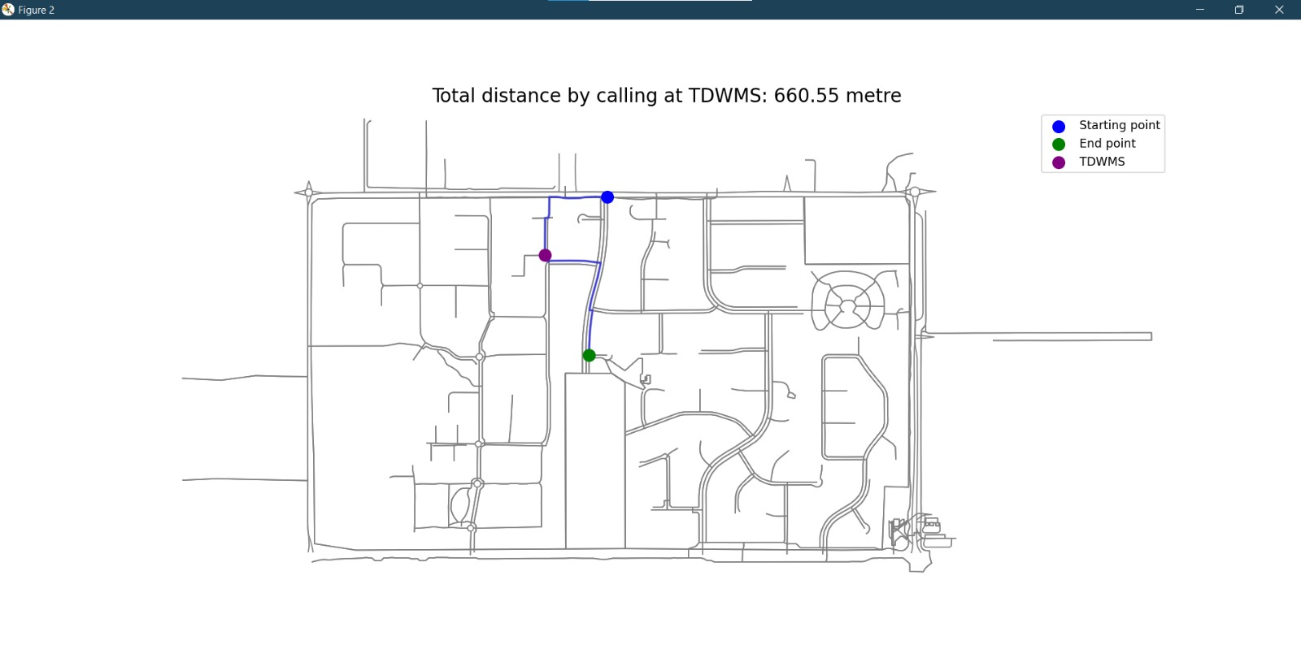
Current Progress-2
GTU – COMPUTER ENGINEERING DEPARTMENT CSE 495/496 9

Slide 16
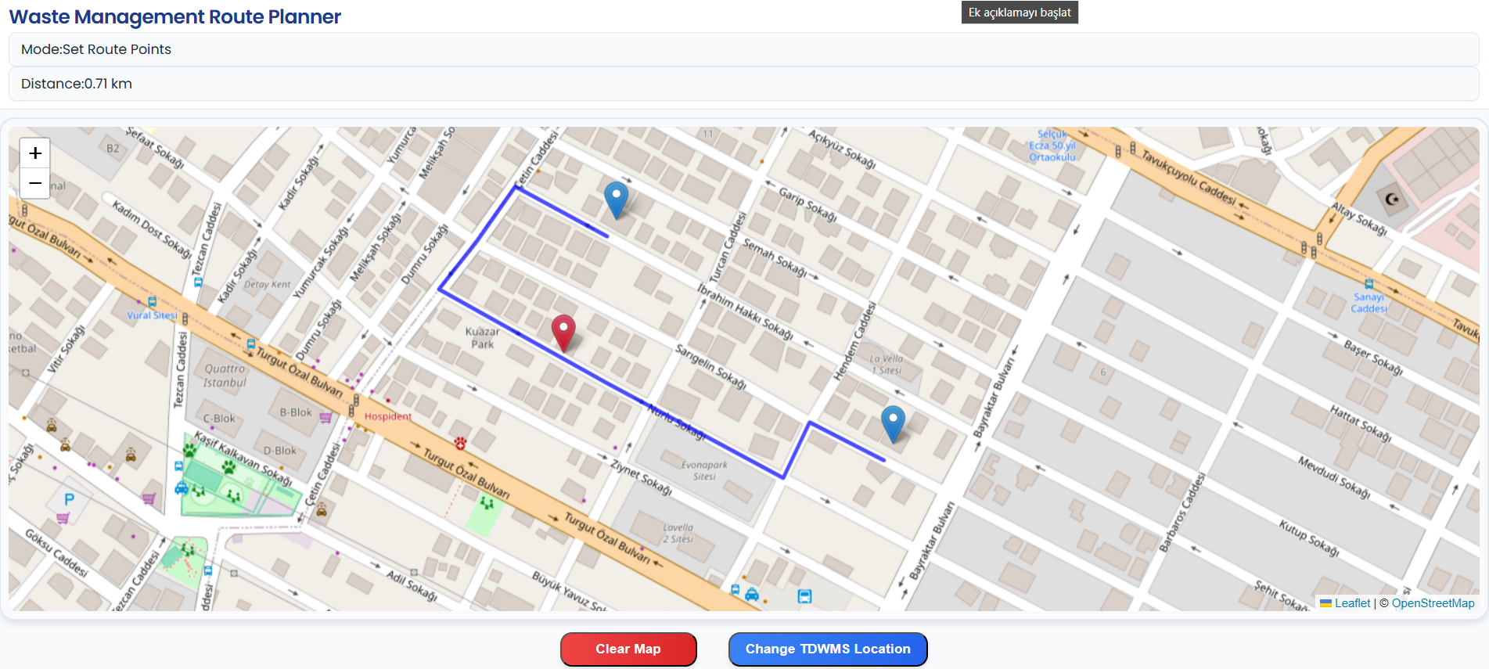
Current Progress-3
GTU – COMPUTER ENGINEERING DEPARTMENT CSE 495/496 10

Slide 17
Next Steps and Timeline
• Complete model implementation in CPLEX
• Finalize data collection and validation
• Begin testing with scenarios
GTU – COMPUTER ENGINEERING DEPARTMENT CSE 495/496 11

Slide 18
Success Criteria
Time and Cost Efficiency
TDWMS Location and Capacity Optimization
Integration of Demolition and Transport Processes
Implement the model in CPLEX with a reasonable optimization gap for practical and efficient solutions.
Design a GUI to visualize the process, including routes, costs, and durations.
GTU – COMPUTER ENGINEERING DEPARTMENT CSE 495/496 12

Slide 19
References
https://www.sciencedirect.com/science/article/abs/pii/S0956053X20305341
https://citeseerx.ist.psu.edu/document?repid=rep1&type=pdf&doi=3dba4ce1e3265e480da88f76d00e53909e775513
https://www.sciencedirect.com/science/article/abs/pii/S0921344922000222
https://www.sciencedirect.com/science/article/pii/S0952197624000903
GTU – COMPUTER ENGINEERING DEPARTMENT CSE 495/496 13

